Slide 1

METAVERSE
WHAT IS METAVERSE

Slide 2

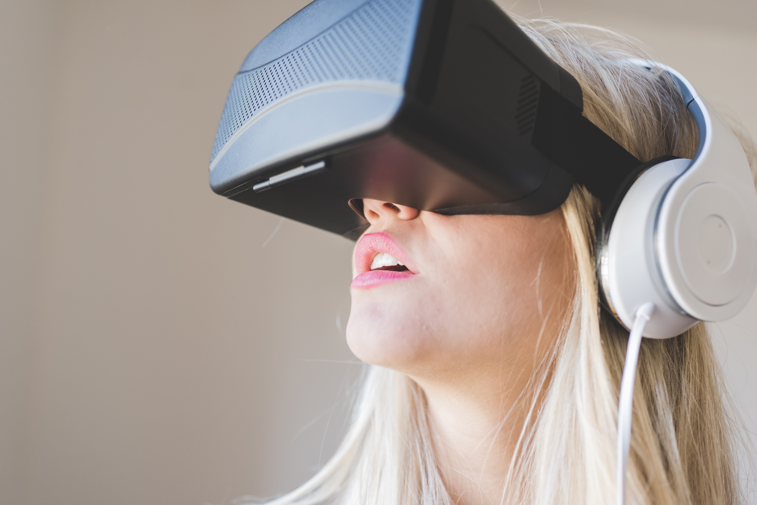
What is Metaverse?
DEFINITION
The metaverse is a concept of an online, 3D, virtual space connecting users in all aspects of their lives. It would connect multiple platforms, similar to the internet containing different websites accessible through a single browser.
A massively scaled and interoperable network of real-time rendered 3D virtual worlds that can be experienced synchronously and persistently by an effectively unlimited number of users with an individual sense of presence, and with continuity of data, such as identity, history, entitlements, objects, communications, and payments. The metaverse will be driven by improved reality, with each user controlling a character or avatar.

Slide 3


What is Metaverse?
HISTORY OF METAVERSE
The term “METAVERSE” was coined by author NEAL STEPHENSON in his 1992 novel SNOW CRASH. For all its influence, Stephenson’s book provided no specific definition of the Metaverse, but what he described was a persistent virtual world that reached, interacted with, and affected nearly every part of human existence. in Snow Crash the Metaverse has made life in the real world worse.
NEAL STEPHENSON
Neal Town Stephenson is an American writer known for his works of speculative fiction

Slide 4
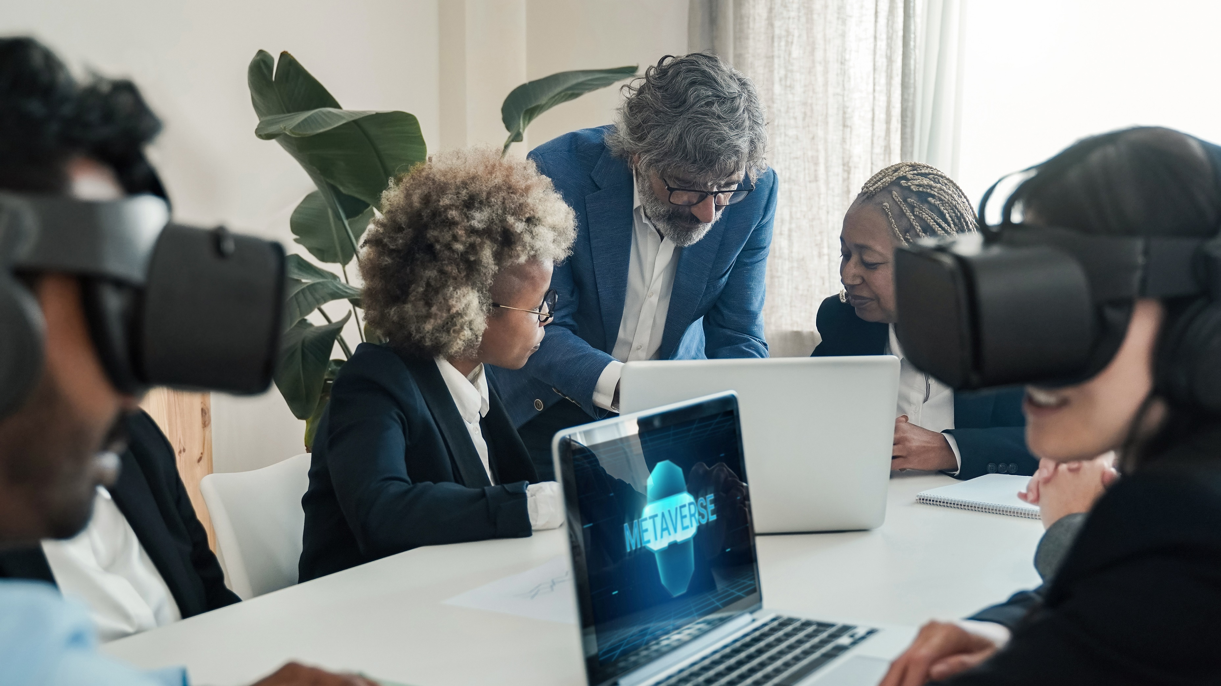
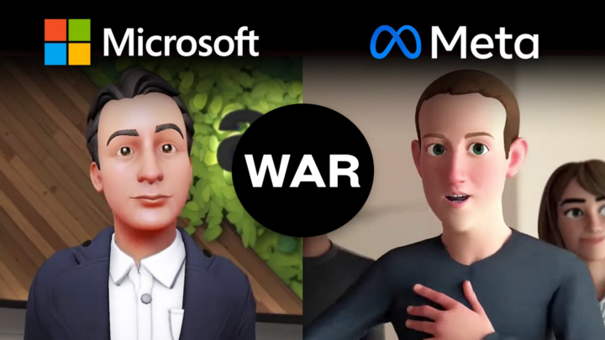
What is Metaverse?
CONFUSION AND UNCERTAINTY
The term “METAVERSE” has no consistent description. Most industry leaders define it in the manner that fits their own worldviews .
Microsoft’s CEO described the Metaverse as a platform that turns the “entire world into an app which could be augmented by cloud software and machine learning
Meta focused on immersive virtual reality as well as social experiences that connect individuals who live far apart
SOMETHING TO KNOW
Whether you’re a Metaverse believer, skeptic, or somewhere in between, you should become comfortable with the fact that it is too early to know exactly what a “day in the life” might look and feel like when the Metaverse arrives.

Slide 5
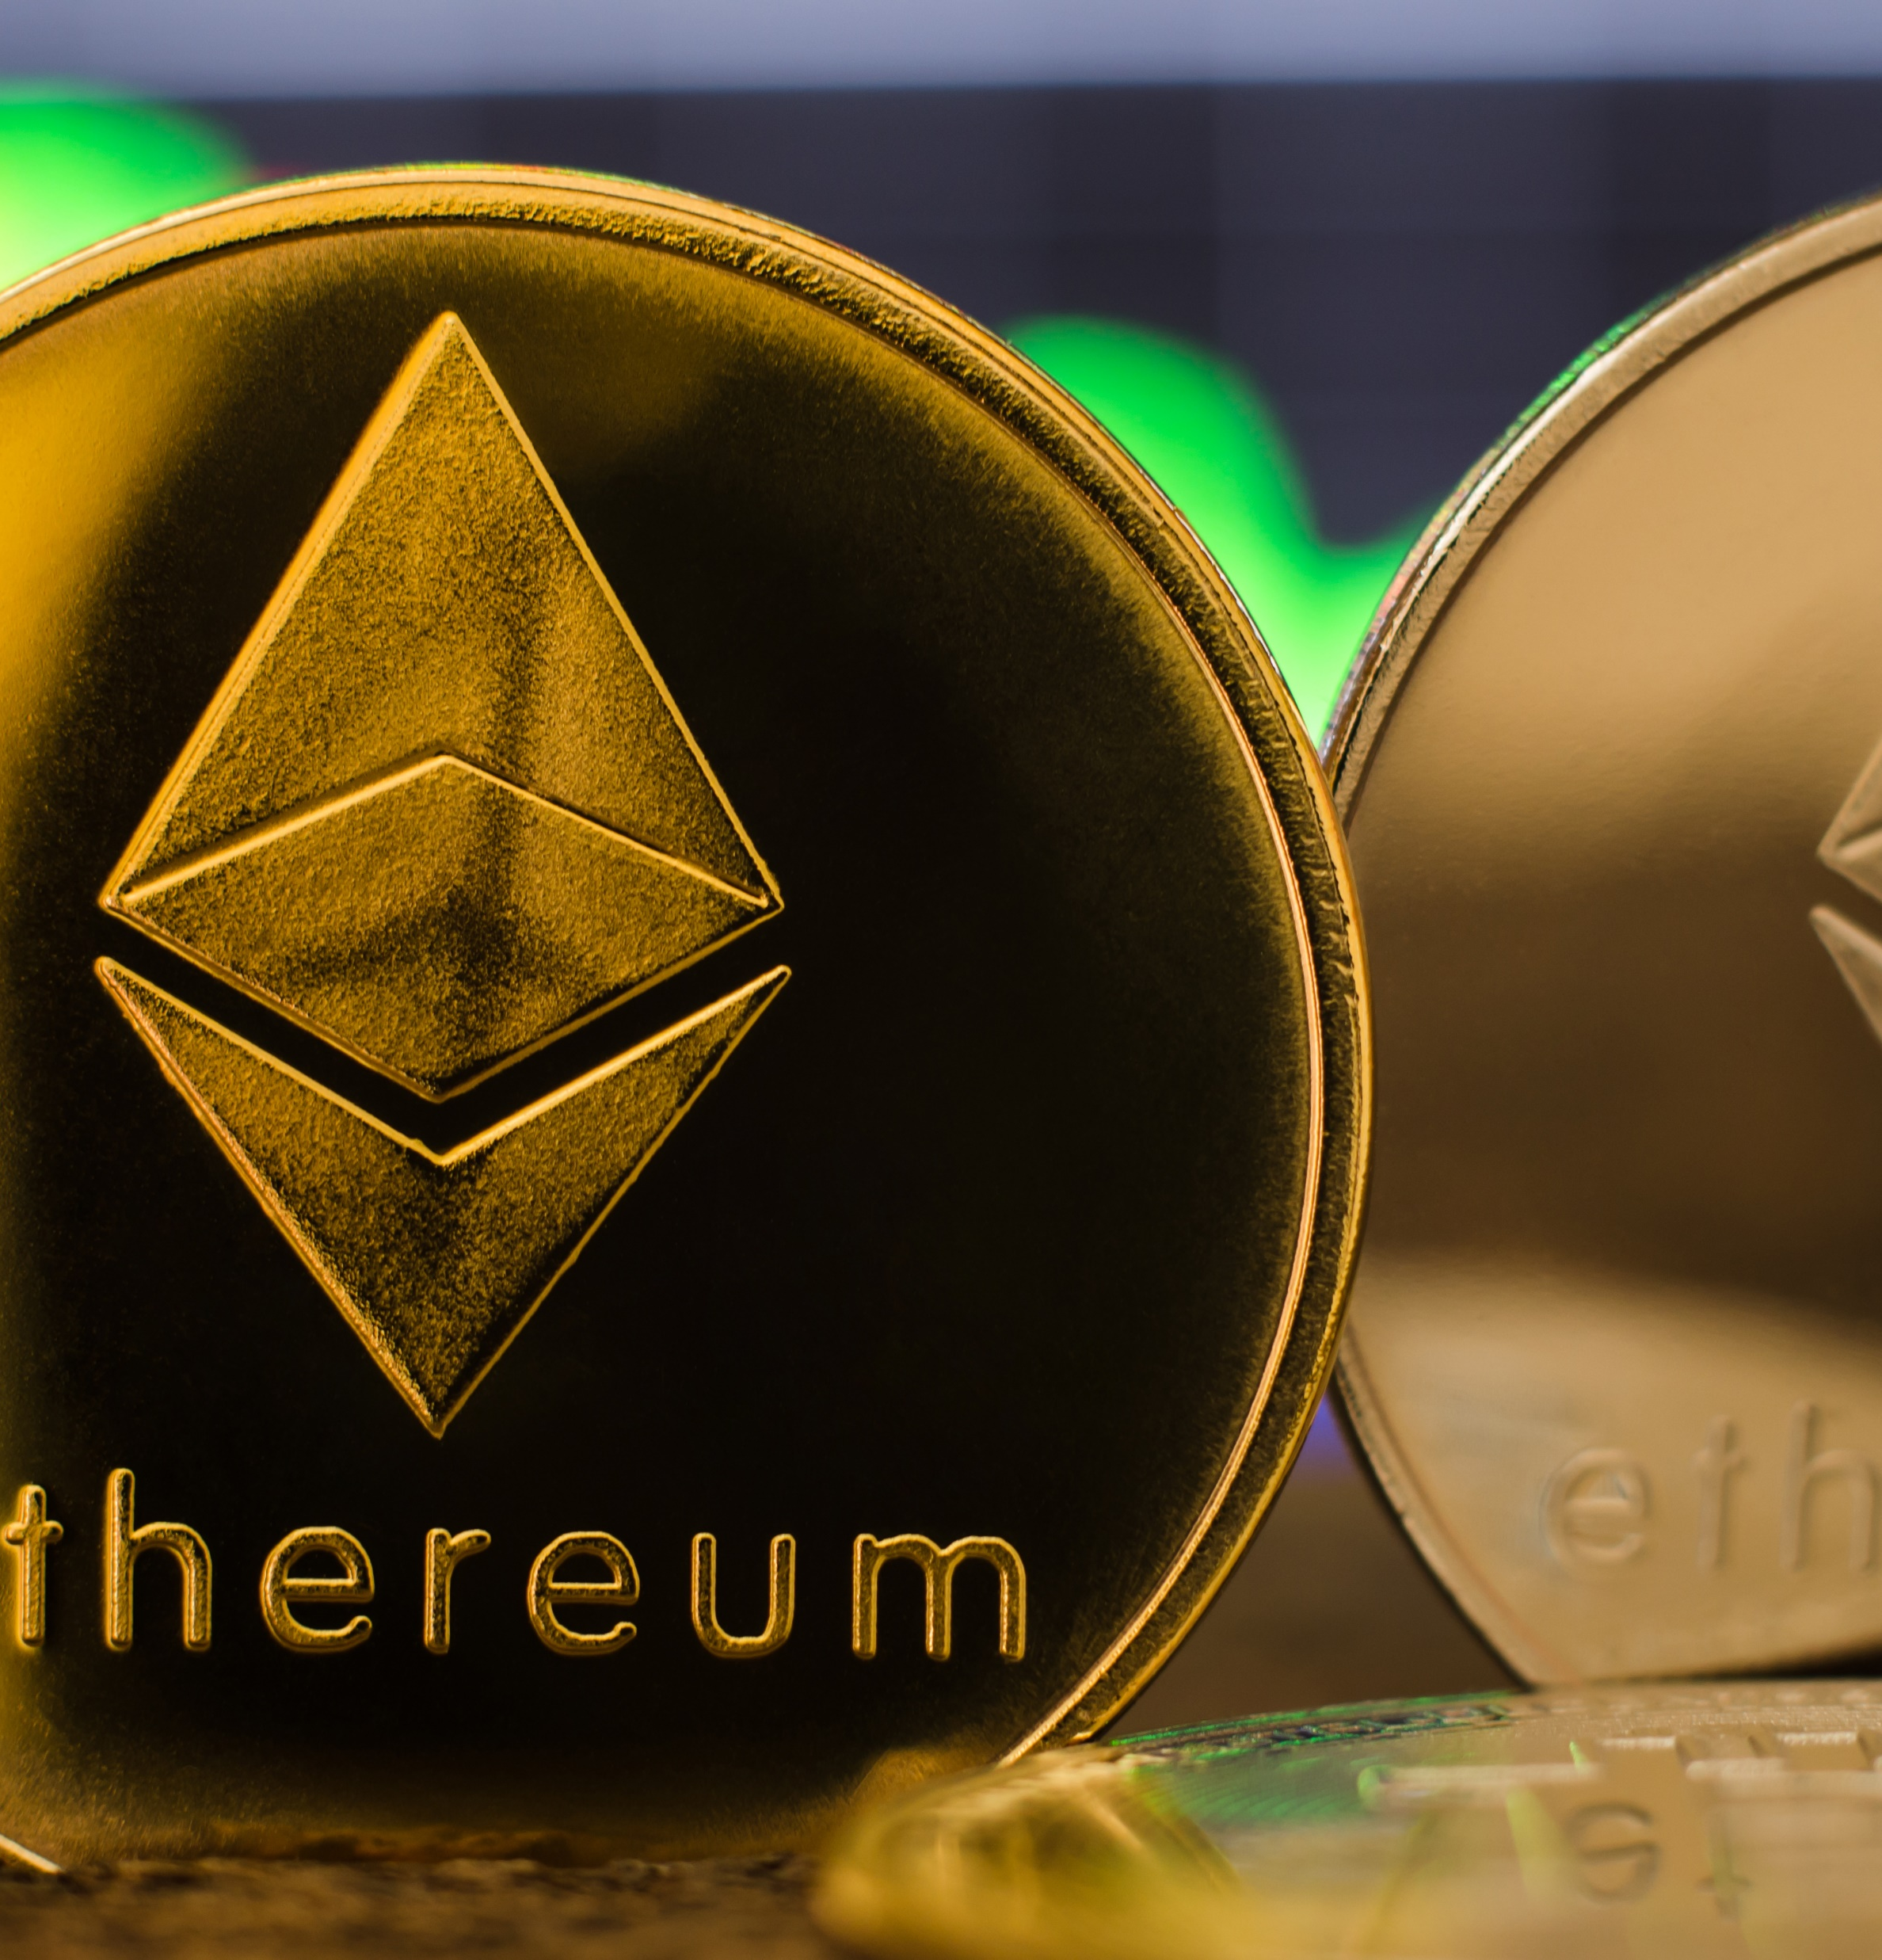
What is Metaverse?
THE NEXT INTERNET
As the newest buzzword in the tech sector, "metaverse" has the potential to open up new growth prospects for companies by enabling them to provide their clients with highly immersive and engaging digital experiences. When Facebook renamed itself ‘’Meta’’ in October 2021, the term "metaverse" passed from the realm of tech nerds to the general public. In the same way, many people believe that the "metaverse" will create a new era of the internet. Facebook has become the most outspoken about the next big thing.
Advancements in technology, like augmented reality and virtual reality, have become more widely available due to smaller and more efficient headgear. As soon as the internet was discovered, many people predicted that everyone would be immersed in cyberspace.

Slide 6
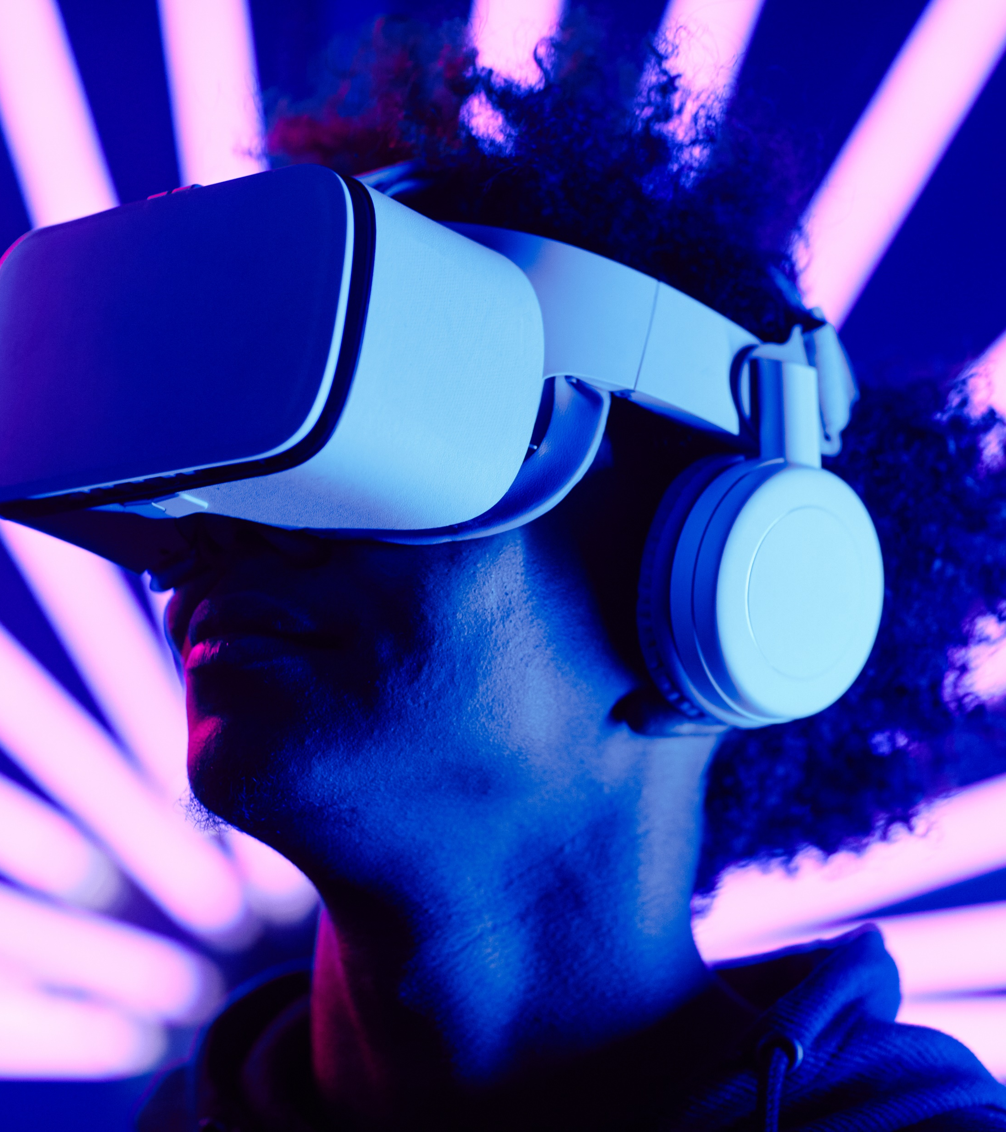
What is Metaverse?
At the moment, we aren't even aware of the extent to which we are interconnected via the internet.
Here are a few reasons why the Metaverse is the wave of the future.
INTERACTION
The current and future state of metaverse opportunities allows us to offer how things can be seen from a different perspective, such as while interacting with friends and family during video chats or in workplace meetings. Face-to-face experiences may also be beneficial in hybrid situations such as meeting with a teacher, consulting with a doctor, personalizing clothes, having a good time at an art display, or simply browsing the sales.

Slide 7

What is Metaverse?
CREATIVITY
Technology like 5G will allow for higher-quality, faster, and more widely available productions regarding future advancements. Combining data and AI would make it easier to implement dynamic creativity in video game programming and augmented reality (AR) and hybrid experiences at events such as festivals and stadiums. Much cutting-edge technology is already abundant on the market.
CAREER OPPORTUNITY
Many new jobs in high-demand fields, including animation, programming, sound design, and art. Speculation among the general public is on who will be in charge of conceiving the Metaverse's foreseeable future. Since it will be a welcoming environment, hopes are high that Metaverse will introduce new courses to help cultivate new talent. However, it will be some time until things begin to get going.

Slide 8
REFERANCE
https://www.brisklogic.co/is-metaverse-the-next-internet-revolution/
https://www.zenesys.com/blog/metaverse-the-next-internet-revolution#:~:text=Metaverse%20is%20the%20invention%20of,headsets%20like%20the%20Oculus%20Quest.
https://en.wikipedia.org/wiki/Metaverse

Slide 9
THANK YOU

